Slide 1

2025 Stroke Public Awareness Collaboration Project
Informational Webinar
January 30, 2025

Slide 2
Disclosure
We will record the Question segment at the end of this session, for our internal use only.
This is to make sure we accurately note the questions that are asked.
We will post on the project website the slides for this session, as well as the questions asked and the answers. We will not identify the individual who asked the question or the organization they represent.

Slide 3
Goal of the project & priority populations
Who can apply?
Lead and partner organizations
Eligibility
Examples of eligible & ineligible activities
Budget
Application process & timeline
Questions?
Agenda

Slide 4
Goal of the Project
The goal of the initiative is to support organizations, to conduct stroke related public awareness activities within their communities, with special emphasis on reaching people who are at highest risk for stroke.

Slide 5
Priority Populations
Priority Populations include:
People at highest risk for stroke:
  Black non-Hispanic, Asian non-Hispanic, and Hispanic adults
  Older adults (65+)
  People who smoke
  People who have diabetes, hypertension, or who have had a stroke in the past
Communities who may not be reached through traditional public awareness activities:
  Black non-Hispanic, Asian non-Hispanic, and Hispanic adults
  People with limited English proficiency
  Rural communities
  Low-income groups
  Individuals with limited internet access

Slide 6
Who Can Apply?
Interested organizations should seek out collaborative partners to conduct public awareness activities together.
Minimum eligible partnerships include
2 organizations from 2 different domains.
More than 2 organizations is fine.

Slide 7
Lead Organizations
EMS
Hospitals
Post-acute [rehabilitation hospitals, home care agencies, skilled nursing facilities]
Community Health Centers/Primary Care
Community-Based Organizations providing resources to at risk populations (e.g. social services and/or chronic disease prevention services)
Local health departments
Faith-based organizations

Slide 8
Responsibilities of Lead Organizations
Pre-award: Submitting application materials (application + letters of participation) by application due date.
Post-award: May act as fiscal agents, depending on project need.
3. Post-award: Participating in activities and collecting signed photo
releases.
4. Post-award: Participating in check-in calls with Borderland Partners.
5. Post-award: Submitting final report and other docs (eg, photos).

Slide 9
Responsibilities of Partner Organizations
Pre-award: Submitting application materials (letters of participation) by application due date.
Post-award: May act as fiscal agents, depending on project need
Post-award: Participating in activities and collecting signed photo releases.
Post-award: Participating in check-in calls with Borderland Partners.
Post-award: Contributing to final report and providing other documents (eg, photos).
Notes:
Examples of community organizations; YMCA, Meals on Wheels, Libraries, Senior Centers…

Slide 10
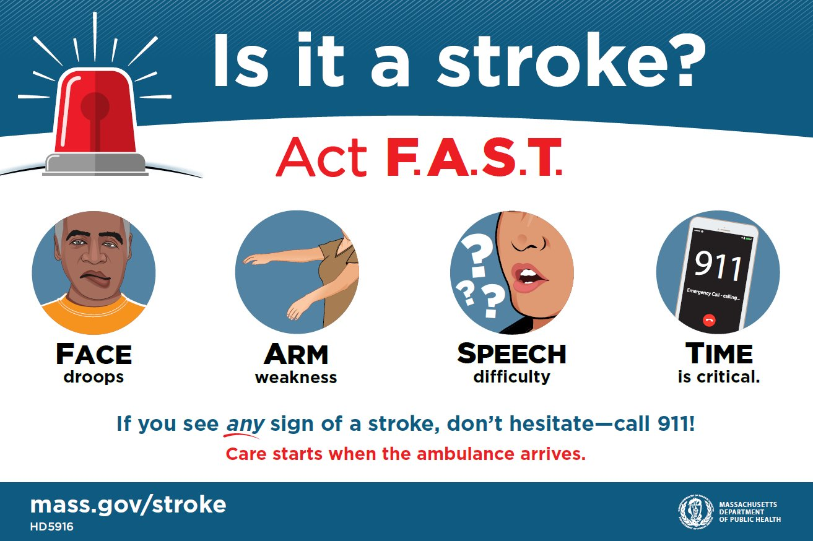
Eligibility
Eligible projects must involve collaboration between two or more organizations to carry out stroke awareness activities.
Signs and symptoms of stroke, including F.A.S.T.
What to do if you suspect you, or someone else, is having a stroke.
Risk factors for stroke.
Ways to decrease risk of stroke.

Slide 11

Examples of Eligible Activities
Hosting a stroke education table or activity at a local community event that is likely to reach the target population.
Partnering with other organizations to distribute F.A.S.T. materials to clients during service delivery.
Developing a stroke awareness message to be delivered at a sporting/theater/music event.
Hosting a series of stroke education sessions in-person or virtually during May, Stroke Month.
Hosting a large/small community education event.
Salaries for staff when they are working directly at an event.
Notes:
BP Screening in the community.
Purchasing equipment that can be used for community education and will be used for the same purpose at the end of the project year. For example a laptop or Ipad, give aways that may continue to be distributed after the project ends, vouchers for healthy food purchases at farmers markets,

Slide 12
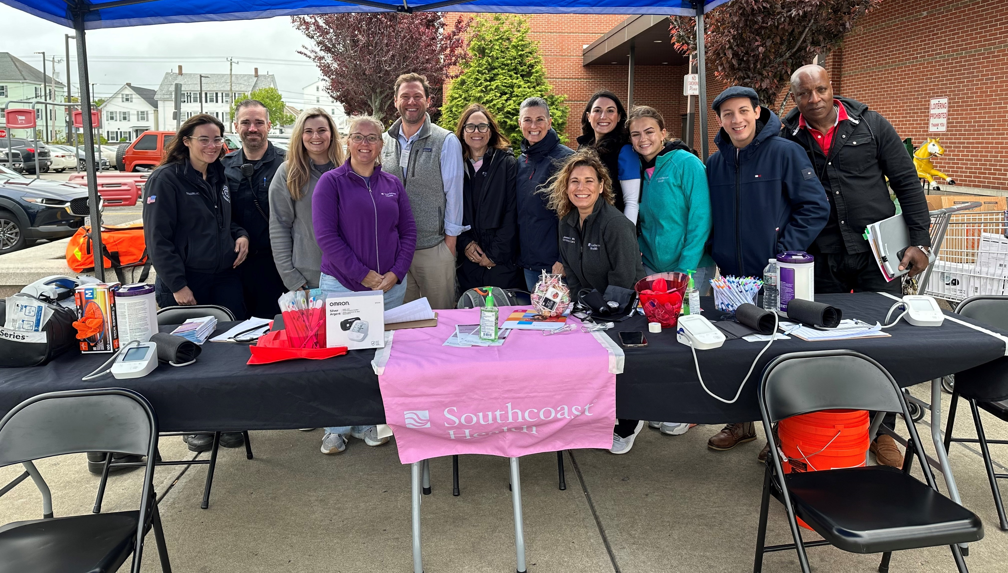
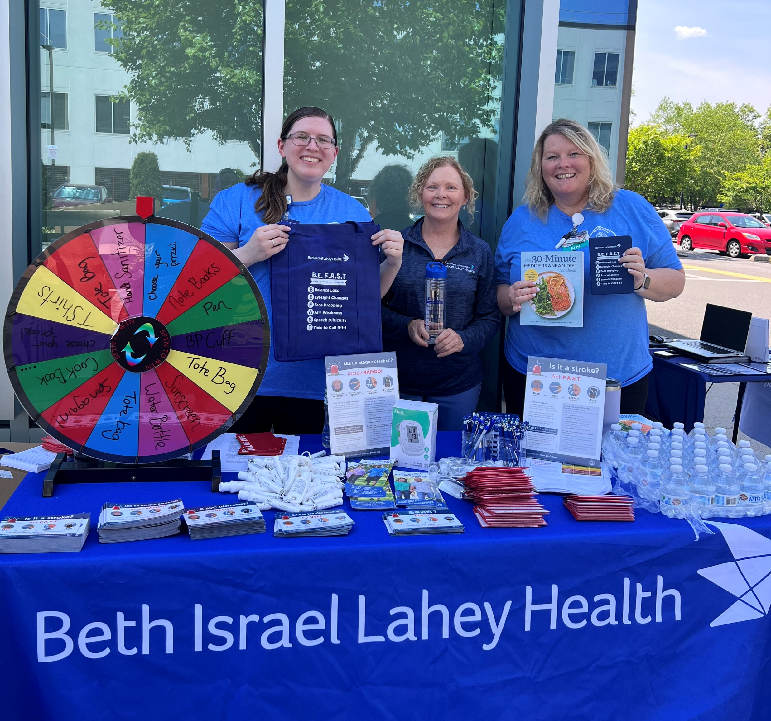
Examples of Past Activities
These are examples of photos we can share about your work courtesy of the media release forms and final reports you submit. They are greatly appreciated!

Slide 13
Examples of Ineligible Activities
Indirect (overhead) costs for lead organizations and their partners.
Funding used to educate applicants’/partners’ staff or providers.
Any event where attendees are staff of any of the organizations (for example gala, breakfast, team outing).
Creating collateral materials that duplicate what is already available in the Massachusetts Clearinghouse.
Equipment or technology that is not directly related to educating the community and/or patients at risk for or recovering from stroke.
Notes:
We will not pay to create collateral materials that are the same as what is available and the organization logo is attached.
We can provide the files of the materials in the Clearinghouse if groups want to use the artwork to reprint---but this would not be an allowable expense.

Slide 14
Budget
Number and size of awards will depend on the number of organizations that apply and meet funding criteria.
Budget is broken down into “Lead organization” and “Partner organization(s).”
Applicants are asked to specify Staff, Supplies, Equipment, and Other expenses, and to justify the amounts requested.
Estimated expenses are ok.
All funded activities must be completed by June 27, 2025.
$20,000 MAX
Award
Notes:
Please be as specific as possible when writing the budget.

Slide 15
Application Process
Lead organizations complete the application (available at https://borderland-partners.com/strokeawareness).
Lead organizations submit the required documents via email to stroke@borderland-partners.com
Required documents consist of:
    Completed application form (Word Document or PDF)
    Completed budget (found on the final page of the application)
    Letter of Participation for each collaborative partner/site (Word Document or PDF)
4. The application materials are due no later than 5 pm on February 14, 2025.
    No late submissions will be accepted.
5. Selections will be announced Monday, February 24, 2025.

Slide 16
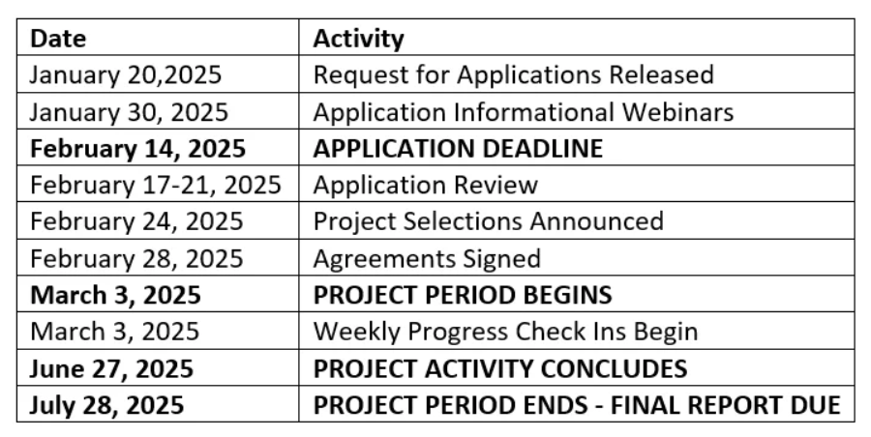
Project Timeline

Slide 17
Questions?
Questions about the funding and application process should be directed in writing via email to stroke@borderland-partners.com
(No questions by telephone).
Q&As will be posted on the Stroke Public Awareness Collaboration Project’s dedicated web page, at https://www.borderland-partners.com/strokeawareness, within 48 hours of receipt. Borderland Partners will redact any identifying information included in the question.
Questions will be accepted until Friday, February 7, 2025.

Slide 18
* Pause *
We will pause here to start recording
the questions.

Slide 19
Your Questions?
These slides, as well as all questions and answers, will be posted to the Stroke Public Awareness Collaboration Project’s dedicated web page, at https://www.borderland-partners.com/strokeawareness, within 48 hours of the conclusion of today’s webinars.

Slide 20
Thank you!
Paula De Santiago, Ed.D.
Alba De Santiago

